Slide 1
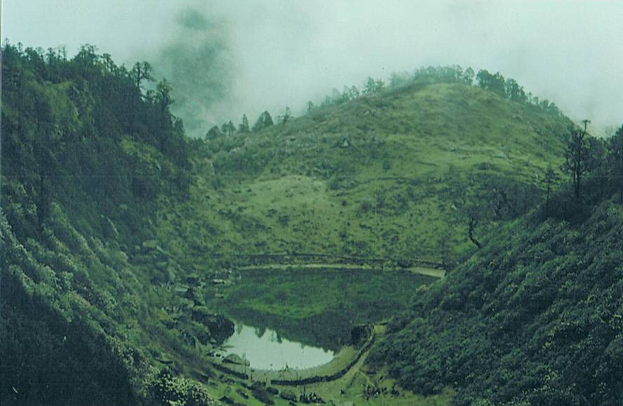
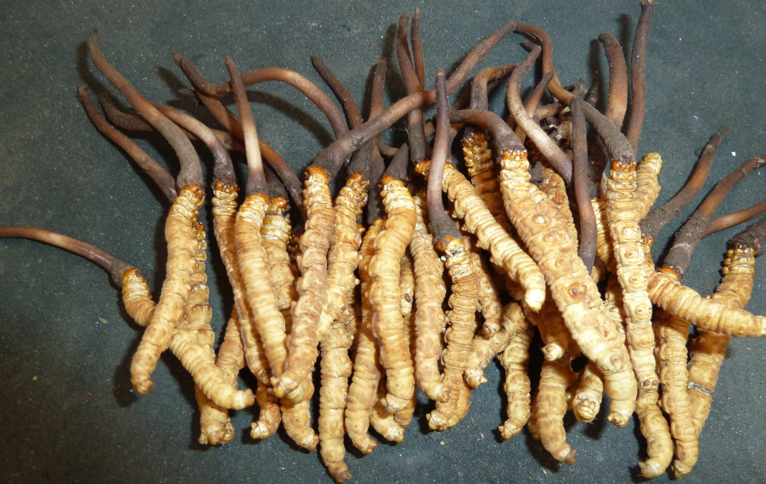
Indigenous Peoples and Local Communities Work towards Socio -economic Consideration and Risk Assessments of Living Modified Organisms
The Action Agenda for Nature and People:
Key to the Implementation Plan for the Cartagena Protocol on Biosafety and protecting biodiversity
For indigenous peoples and local communities (IPLCs) Mother Nature is alive and sacred.
Nature is embedded in our own languages, ritual, religious, ceremony, symbol, spiritual, cosmos, customs and identities and on biodiversity
Kirant Indigenous, Kamal
Sept 27, 2021

Slide 2
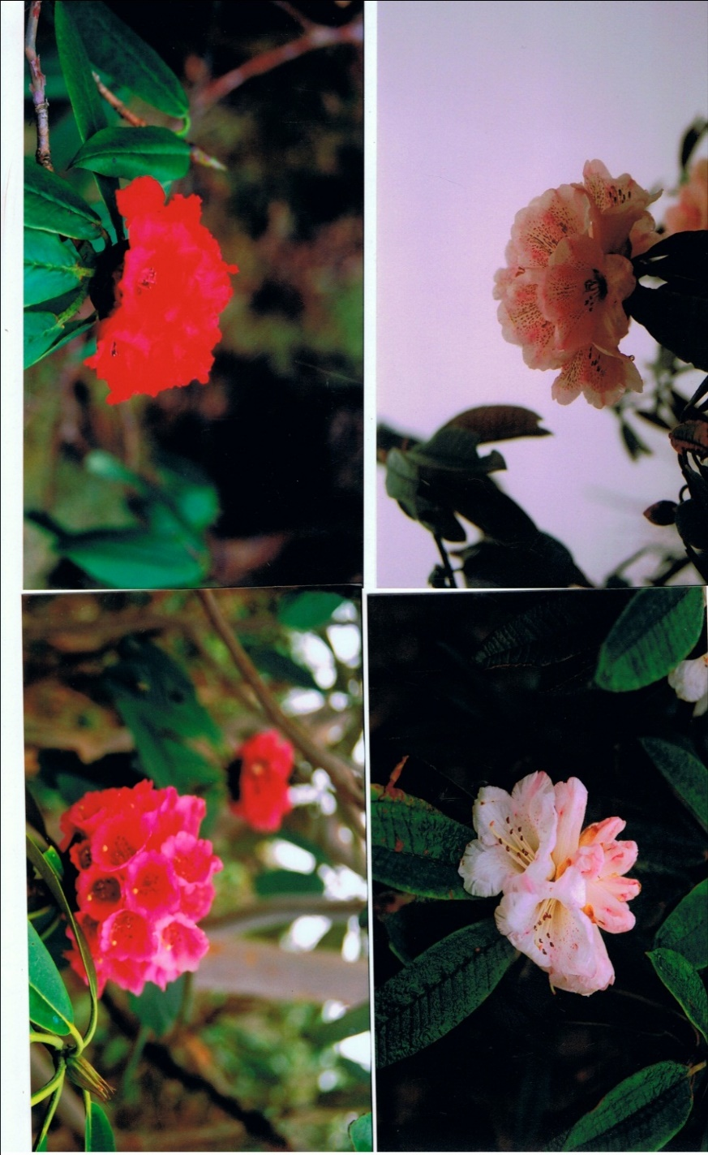
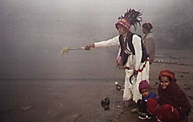

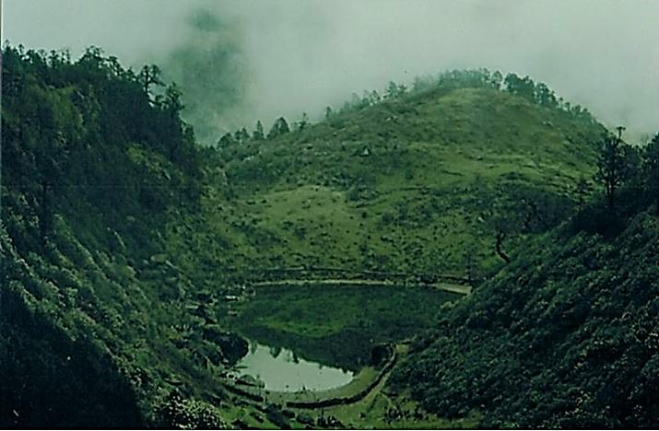

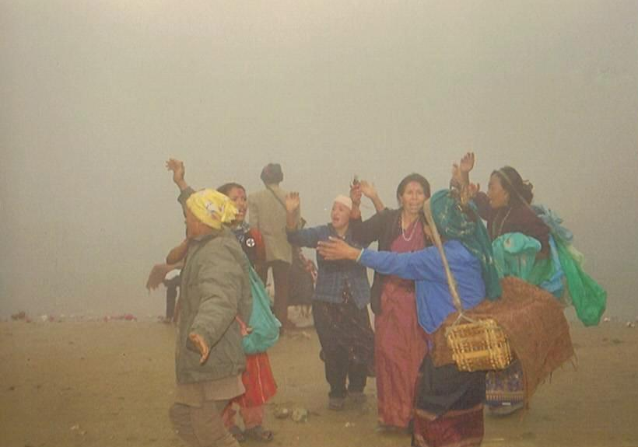
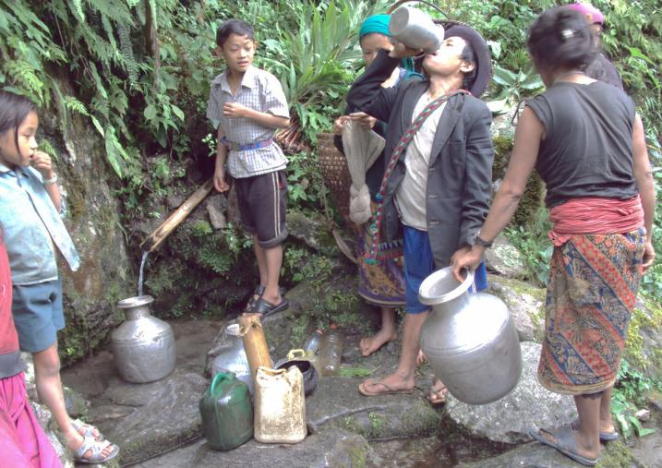
IPLCs and Biodiversity
Customary systems and socio- cultural footprints of IPLCs, women and elders are deeply rooted with Nature, land, water, territories and resources.
IPLC values and systems play a vital role on traditional livelihoods and socio economic development and protecting biodiversity and the transfer of the knowledge to the young generation to continue the customary practices harmony with Nature

Slide 3
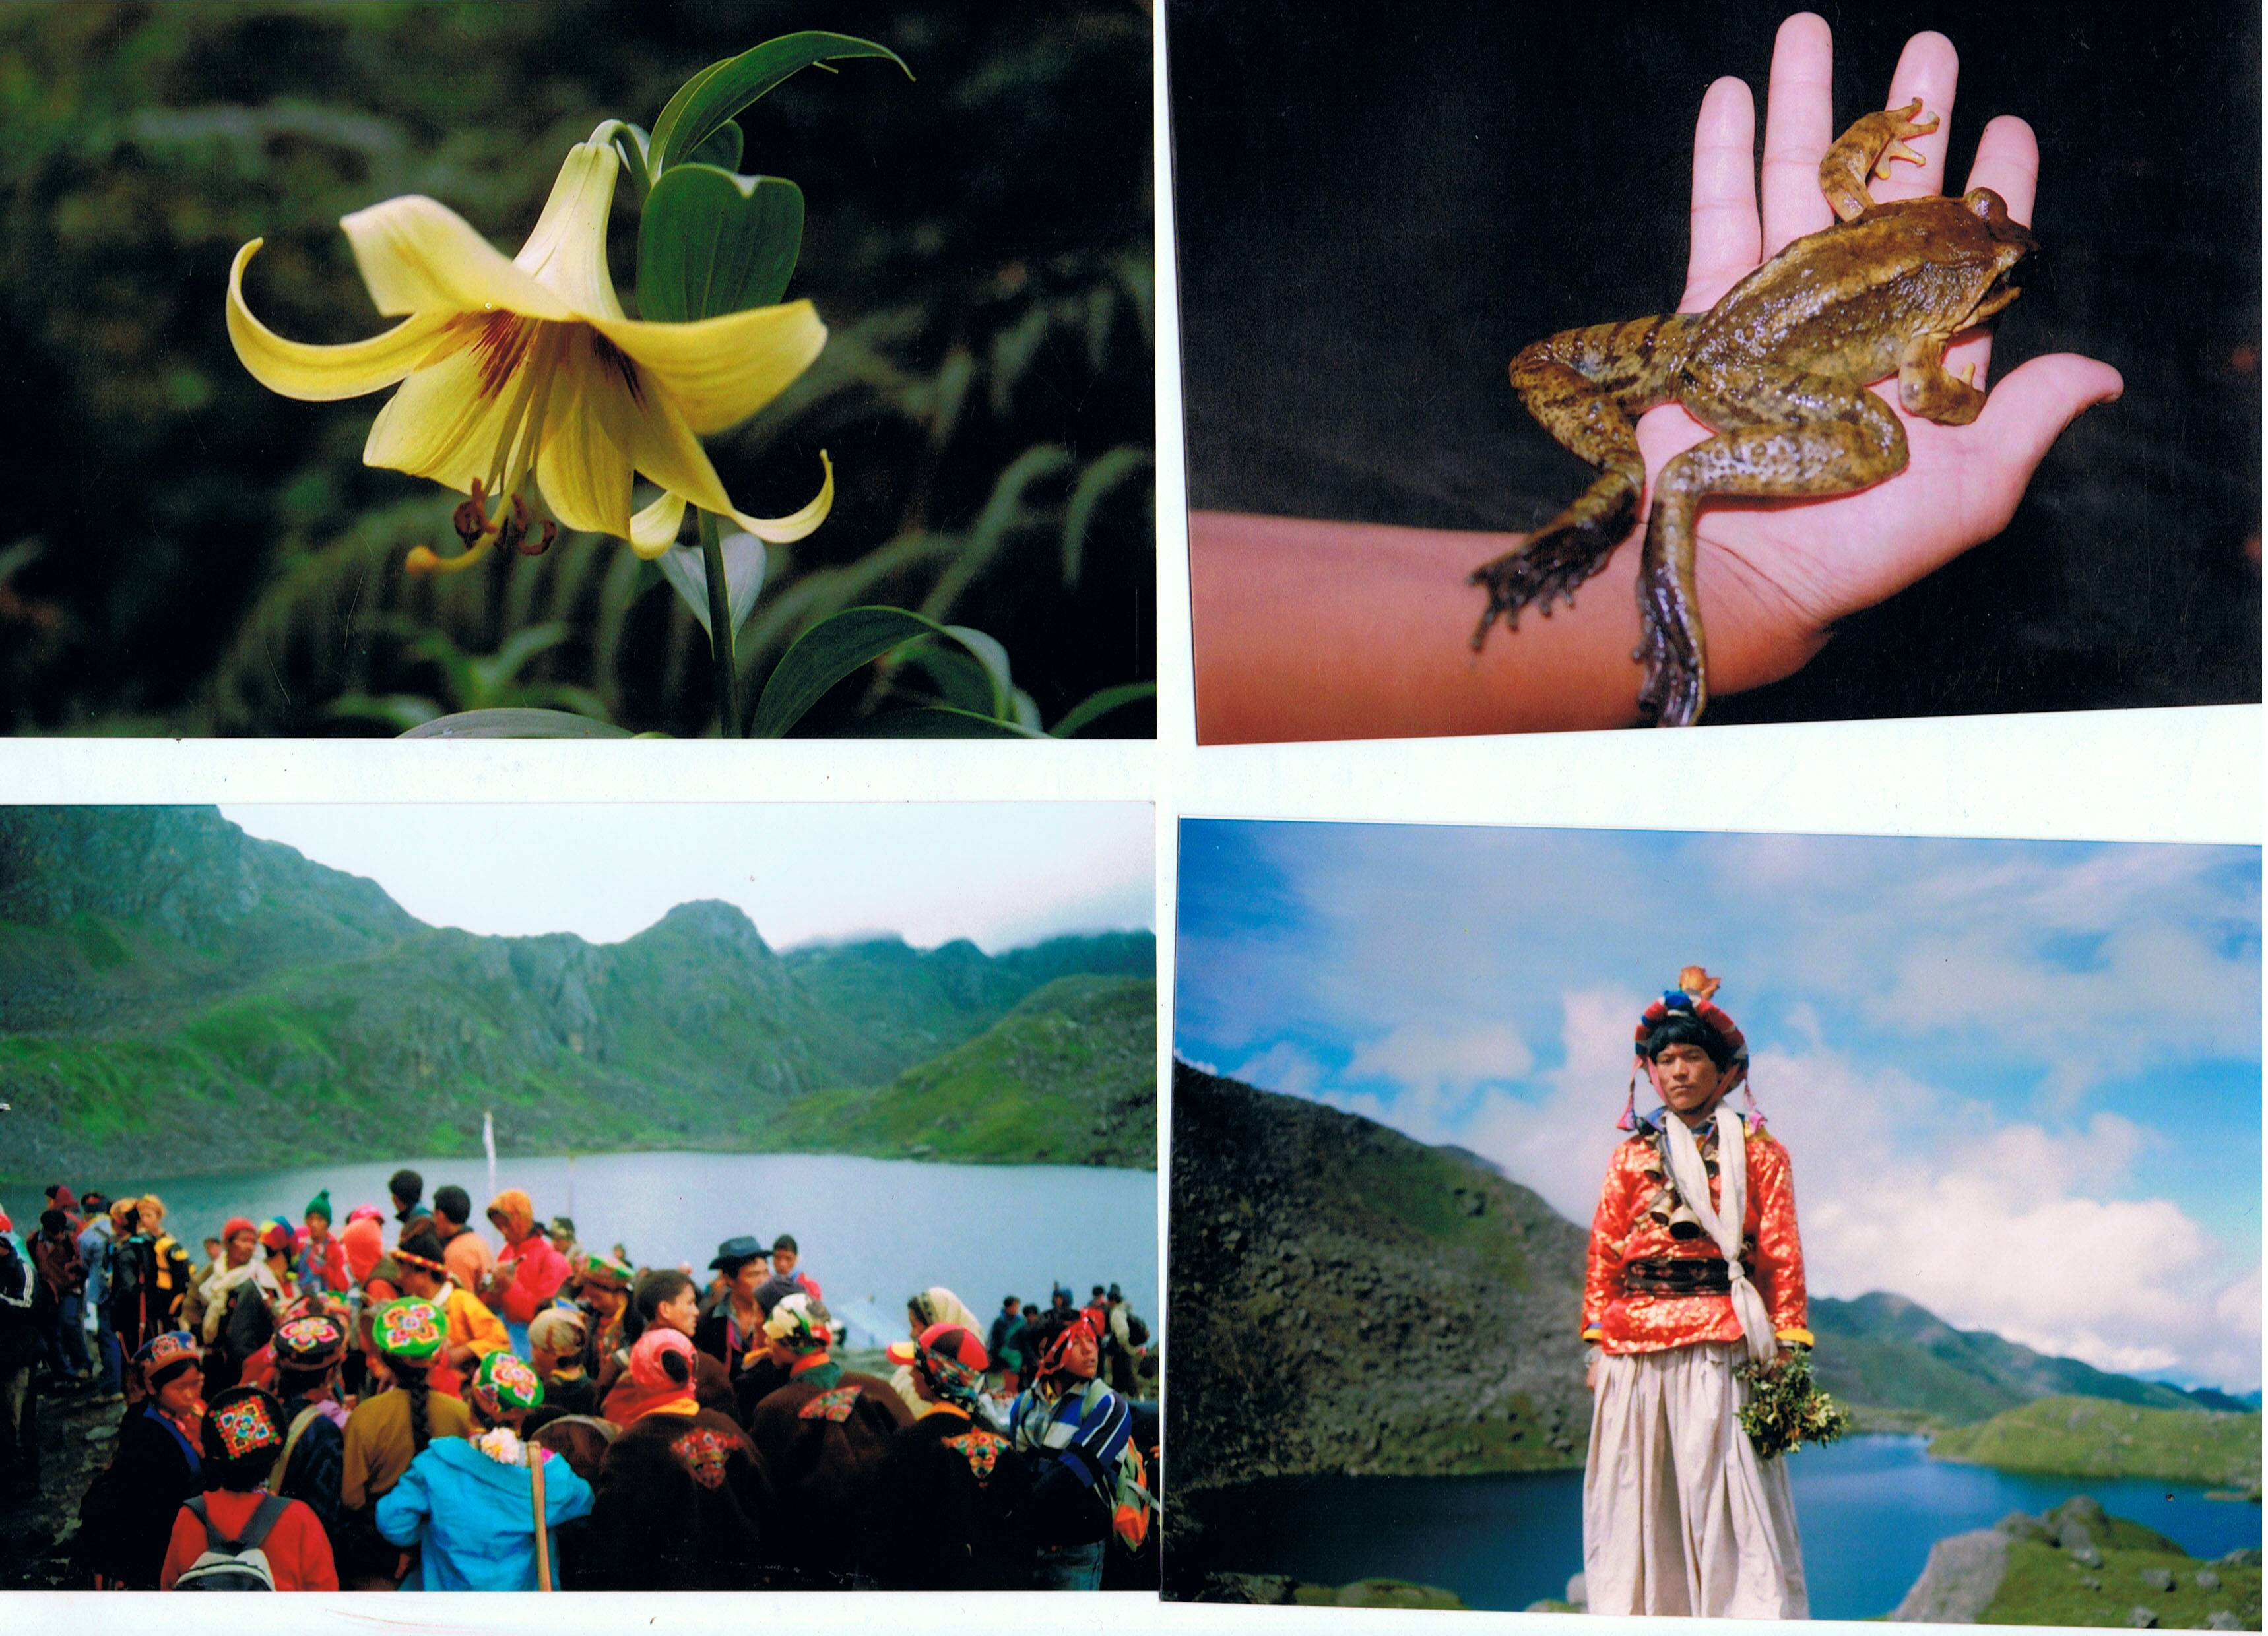
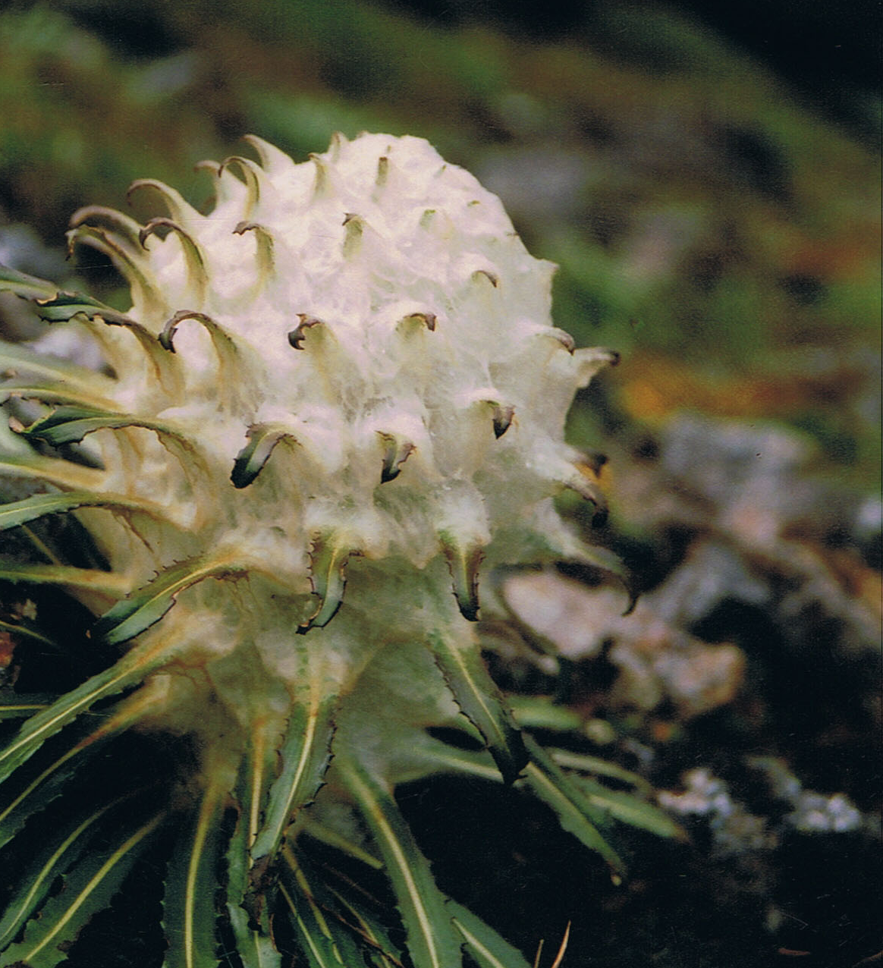
LMOs and IPLCs
LMOs resulting from biotechnology are of concern to IPLCs, women and youth
The ± impacts of LMOs on species to Mother Nature, land, water, ecosystems, territories, resources, livelihoods and socio – economic issues are not yet well known.
Risk assessment and risk management of LMOs, participatory research of LMOs is not design to meet cultural values for IPLCs
Lack of access, know how, capacity building, communication, education and knowledge transfer are key issues to consider for IPLCs, women and youth

Slide 4
Action Agenda Commitment:
Socio-economic considerations and capacity-building
In the Implementation Plan for the Cartagena Protocol on Biosafety:
The socio-economic considerations’ guidance from the SCBD widely made us of by 2030, IPLCs, women and youth from the seven geographical areas
IPLCs, women and youth socio-economic considerations (Article 26 of the Protocol) are key when LMOs are imported, including considerations for territories, land, water, ecosystems.
Scientific transfer of technical knowledge is key to support IPLC, women and youth.
Collaboration and partnerships with IPLCs, women and youth is key to respect traditional knowledge, skills, indigenous technology and innovation

Slide 5
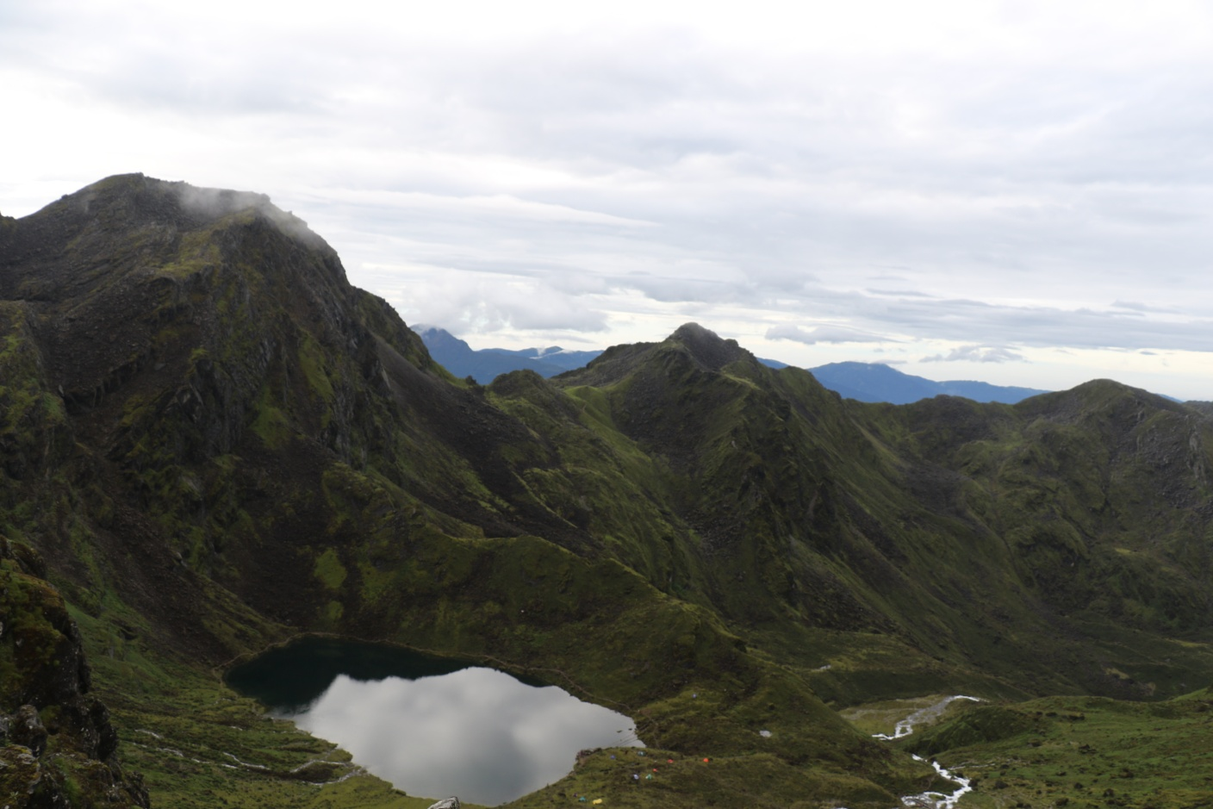
Action Agenda Commitment:
Risk assessments of LMOs
In the Implementation Plan for the Cartagena Protocol on Biosafety:
Risk assessment and risk management of LMOs training for IPLCs by 2030, IPLCs, women and youth, from the seven geographical regions
Free Prior and Inform Consent, Self-determination and full and effective public participation of IPLCs, women, youth and elders is key when conducting risks assessment of LMOs

Slide 6
Our commitment in the Action Agenda for Nature and People is key to the Implementation Plan for the Cartagena Protocol and protecting biodiversity in respect our human rights and in collaboration, precautionary approach:
For risk management and to monitor the impacts of LMOs and promote socio-economic considerations of LMOs
Thank you all!
Indigenous peoples and local communities
Kamal Rai: ipskirantsampang@gmail.com

